Slide 1


Making Private Data Open and Enhancing Decision-Making through Digital Atlases
Prof Helen Thompson, Prof Kerrie Mengersen
Queensland University of Technology
Open Data Science Conference 2023
helen.thompson@qut.edu.au k.mengersen@qut.edu.au

Slide 2
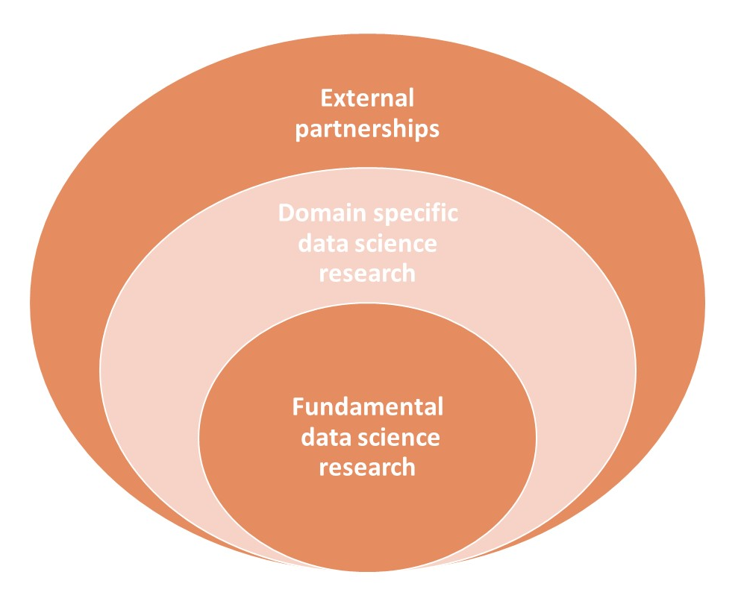


130+ Researchers
100+ HDRs
5 Faculties
20 Partner Organisations
5 Core Programs
11 Applied Domains
Data for Discovery
Models and Algorithms
Complex Data Analytics
Responsible Data Science
Human-Centred AI

Slide 3

ACEMS
AMSI
Swinburne
Monash
RMIT
Queensland
Data61
Victoria
NSW
UTS
Australian Data Science Network
UNSW
Professional Societies
Victoria
UQ
Wollongong
QUT
Western Australia
ACT
South Australia
Melbourne
Uni SA
Deakin
Adelaide
La Trobe

Slide 4
Mathematical Sciences
Information Systems
Computer Science
Information Security
Public Health and Epidemiology
Science
Australian Centre for Health Law Research
Law
Health
Computer Human Interaction
Centres of Excellence
DataScience @QUT
Genomics and bioinformatics
Engineering
eResearch
Cooperative Research Centres
Biomedical imaging
Business
Education
Digital Economy
CI
Transport Research Group
National Centre for Econometric Research
Digital Media Research Centre
Digital Observatory

Slide 5




Case Study: ACA
The Australian Cancer Atlas

Slide 6
Evidence-based Decision-making Platforms
Modern decision-making is commonly supported by digital platforms: e.g., dashboards, atlases.
Pro: Encourages open, complete data
Pro: Allows for more in-depth engagement and interpretation than static reports or articles
Pro: Disrupts the traditional Plan, Do, Act cycle
Con: ... open, complete...
Con: ...interpretation...
Formulate
Question
Make
Decision
Collect
Data
Interpret
Results
Data
Processing
More complex data inspection
Analyse

Slide 7
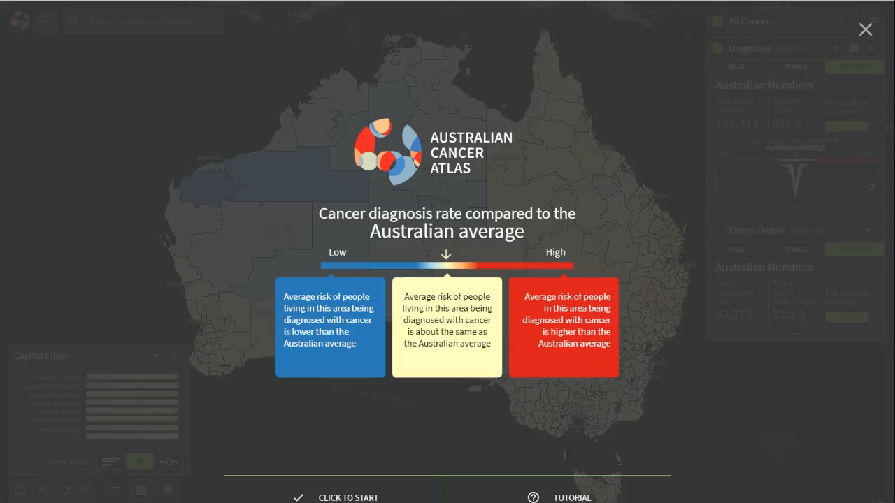

Slide 8
Themes of this presentation
Creating open data
From private to modelled data (Susanna Cramb, ACA team)
Federated learning alternative (Conor Hassan, Rob Salomone)
2. Creating complete data
From survey to census data (James Hogg)
3. Creating interpretable data
Visualisations (Sarah Goodwin, Stephanie Kobakian, Dianne Cook)
Value-add: clusters and indices (Wala Areed, Aiden Price)

Slide 9
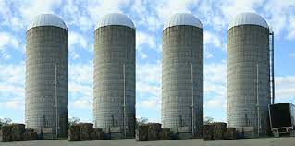
1. The Challenge of open data
Private
Sensitive
Siloed

Slide 10
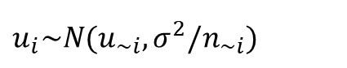
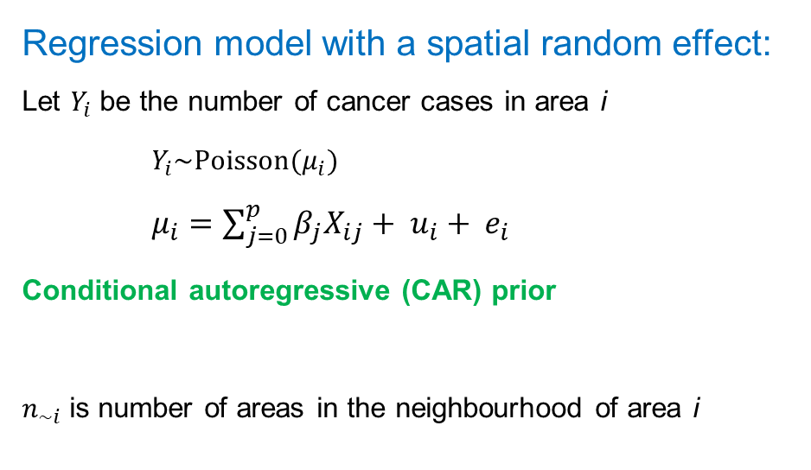
Alternative 1: Bayesian spatial model
Regression model with a spatial random effect: Let $Y_{i}$ be the number of cancer cases in area i
$Y_{i}\sim Poisson(μ_{i})$ $μ_{i}=\sum_{j=0}^{p}{{β_{j}X}_{ij}}+ u_{i}+ e_{i}$
Conditional autoregressive (CAR) prior
$n_{\sim i}$is number of areas in the neighbourhood of area i
 |  | Area i
$u_{i}\sim N(u_{\sim i},σ^{2}/n_{\sim i})$

Slide 11
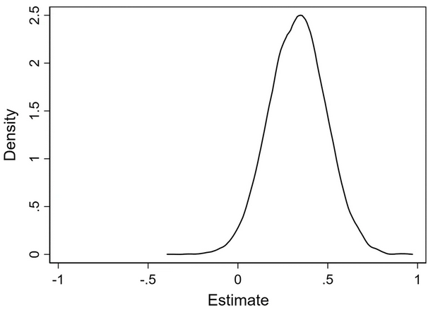
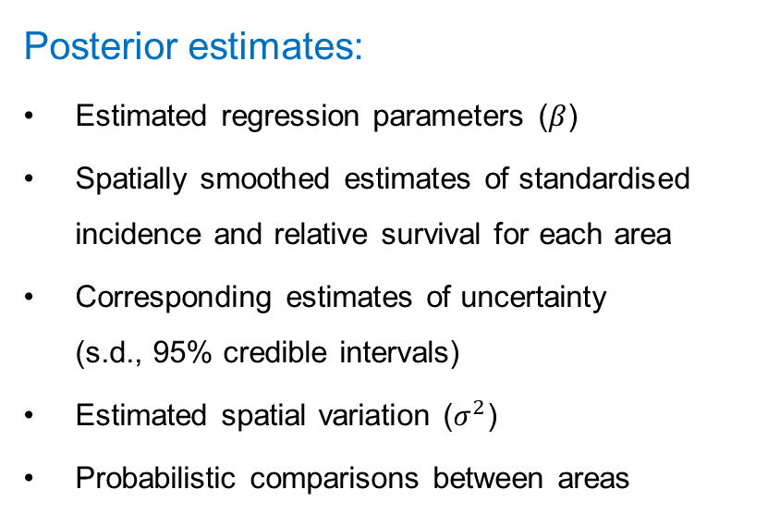
Bayesian spatial model – open (modelled) data
Posterior estimates:
Estimated regression parameters ($β$)
Spatially smoothed estimates of standardised incidence and relative survival for each area
Corresponding estimates of uncertainty (s.d., 95% credible intervals)
Estimated spatial variation ($σ^{2}$)
Probabilistic comparisons between areas
 |  | Area i
Insert posterior
Distribution here

Slide 12
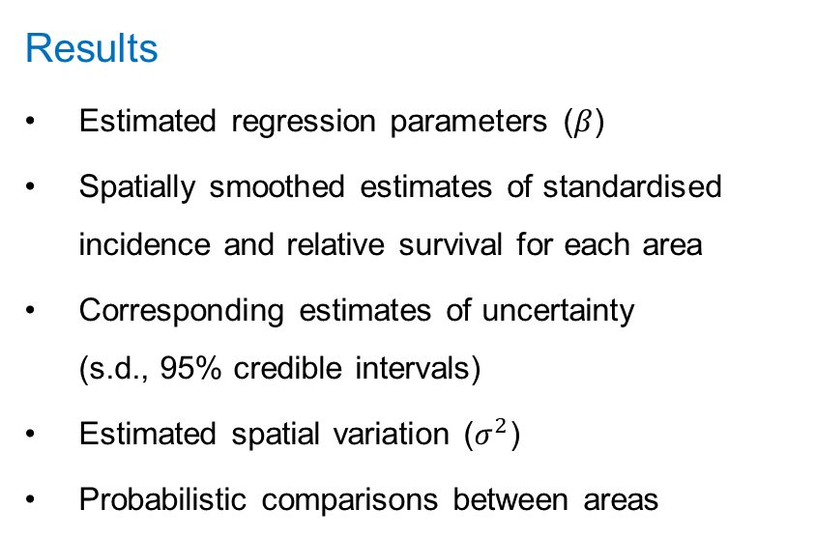
Bayesian spatial model - inferences
Results
Estimated regression parameters ($β$)
Spatially smoothed estimates of standardised incidence and relative survival for each area
Corresponding estimates of uncertainty (s.d., 95% credible intervals)
Estimated spatial variation ($σ^{2}$)
Probabilistic comparisons between areas
 |  | Area i
Insert posterior
Distribution here

Slide 13
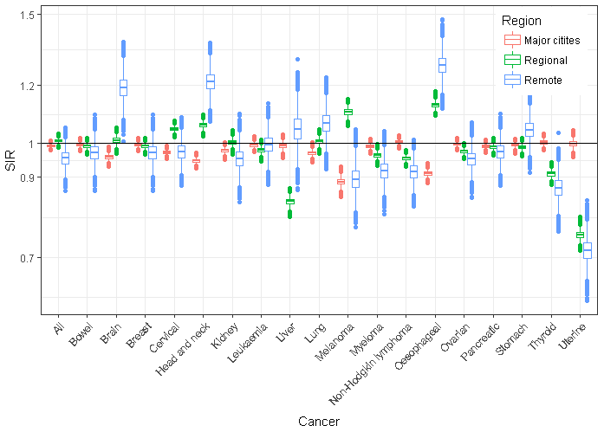
Inferences: Spatial inequalities in incidence - females

Slide 14
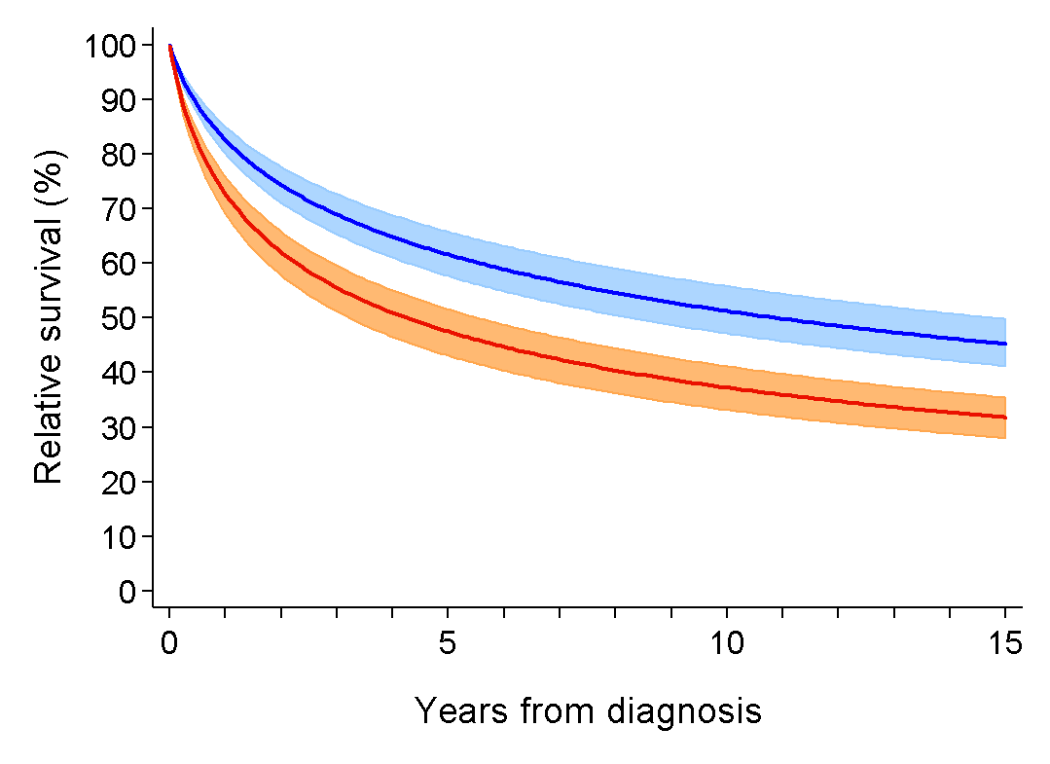
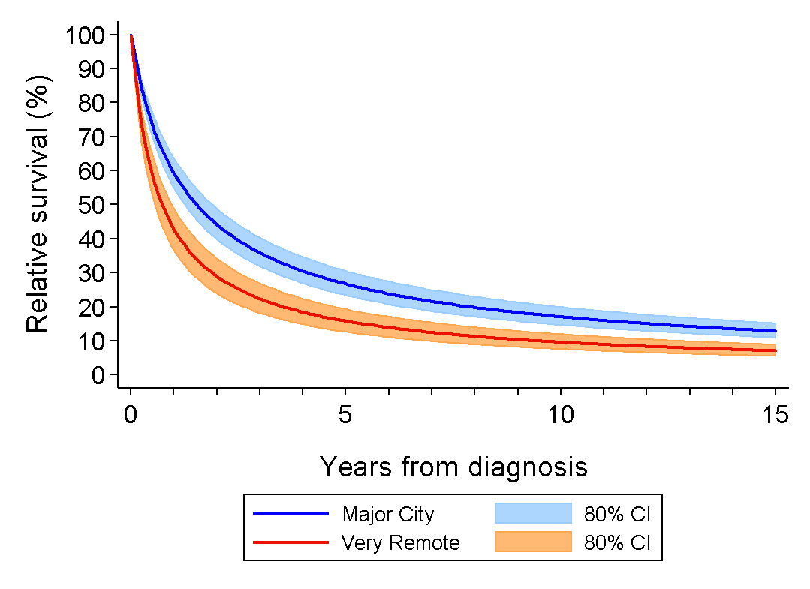
Inferences: Colorectal cancer relative survival curves
Notes:
This differs from colorectal cancer where both localised and advanced colorectal cancers had quite large maximum differences in survival between SLAs, with 5-year survival differences of 4.7% for localised and 14% for advanced, which is a huge differential. The poorer survival for even localised colorectal cancers might also be part of the reason why adjusting for tumour stage didn’t make much difference for colorectal cancer maps.

Slide 15
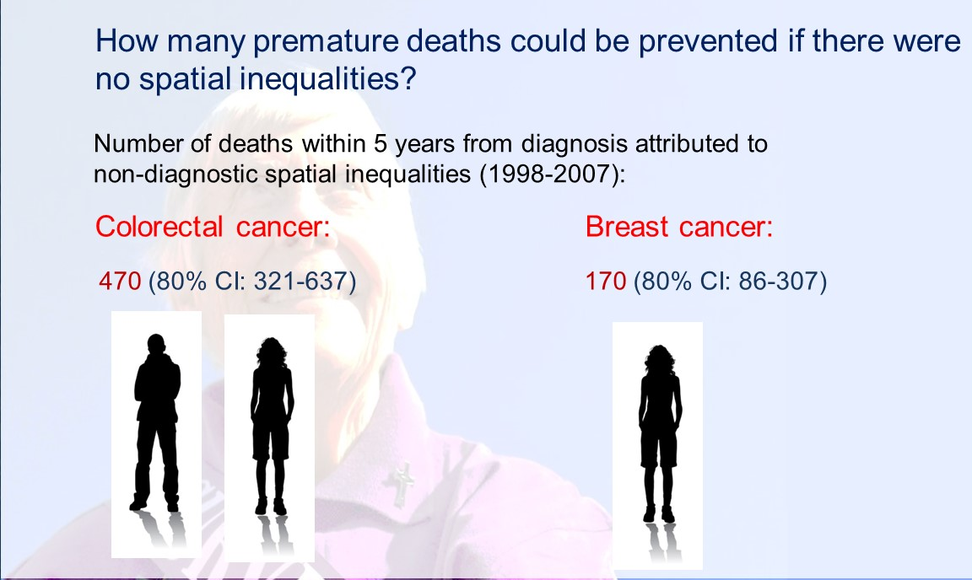

Slide 16
Alternative 2: Federated learning
“Analysis of data without the data leaving the source”
Avoids ethical, legal, political, administrative and computational barriers to combining data from multiple sources
Increases control
Potential to improve data quality & timeliness
Increases inferential capability from small or dispersed datasets

Slide 17
FL in the context of Digital Data Platforms
Cloudera, 2018
Healthcare: “save lives and generate huge value”
Predictive maintenance: “train a better model with less expense”
“… easier, safer and cheaper to apply machine learning in the world’s most regulated, competitive, and profitable industries.”
IBM Research, August 24, 2022
“This new form of AI training is called federated learning, and it’s becoming the standard for meeting a raft of new regulations for handling and storing private data.”

Slide 18
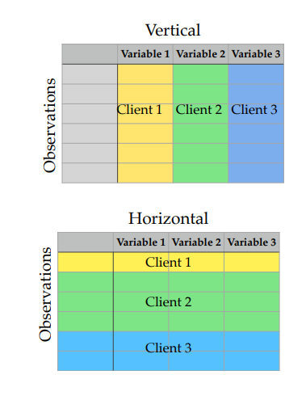
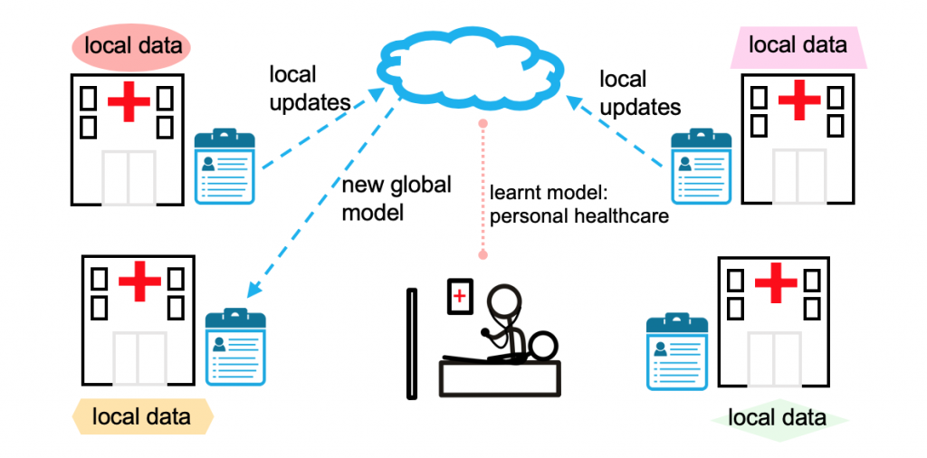
Overview
Li et al. (2020)

Slide 19


FL in the context of the Australian Cancer Atlas
Aim: Combine cancer datasets across states and countries
Inspiration: EuroCare - IKNL Netherlands
Open source
https://github.com/IKNL/ https://vantage6.ai/
atlas.cancer.org.au

Slide 20
Vantage6
EuroCare - IKNL Netherlands
Netherlands and Taiwan: prognostic factors for survival for oral cavity cancer patients – Federated Cox proportional hazards algorithm for horizontally-partitioned data (Lu et al. 2015, WebDisco)
Dutch Cancer Agency and National Registry: structured reporting positive for patient survival – Federated logistic regression for vertically-partitioned data (Li et al. 2015, VERTIGO)
Netherlands and Italy: survival of rectal cancer patients – Federated implementation of the chi-squared test

Slide 21




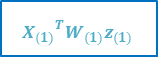
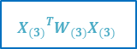
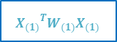
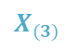

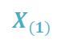

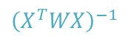
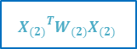
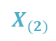
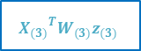
$$X_{(1)}$$
$${X_{(1)}}^{T}W_{(1)}X_{(1)}$$
$${X_{(1)}}^{T}W_{(1)}z_{(1)}$$
β
$$X_{(2)}$$
$${\left(X^{T}WX\right)}^{−1}$$
$$X^{T}Wz$$
$${X_{(2)}}^{T}W_{(2)}X_{(2)}$$
$${X_{(2)}}^{T}W_{(2)}z_{(2)}$$
$$X_{(3)}$$
$${X_{(3)}}^{T}W_{(3)}X_{(3)}$$
$${X_{(3)}}^{T}W_{(3)}z_{(3)}$$

Slide 22
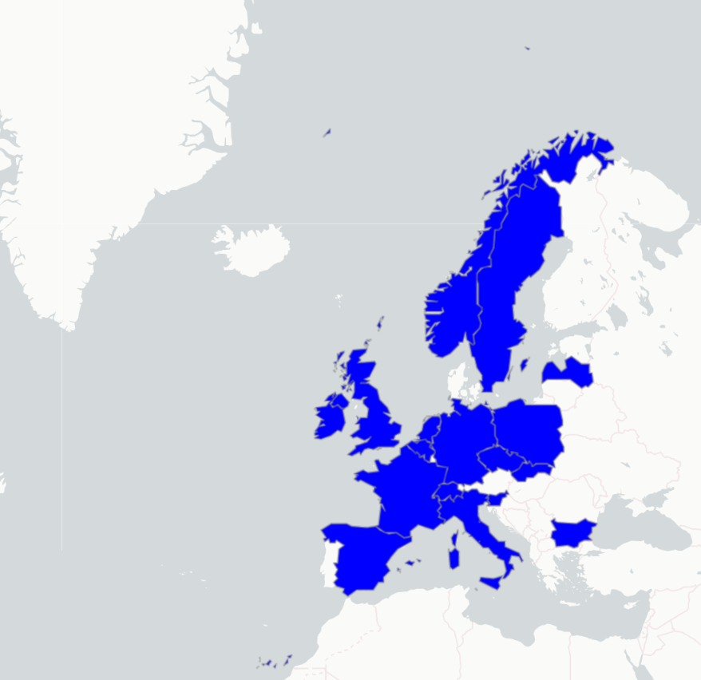
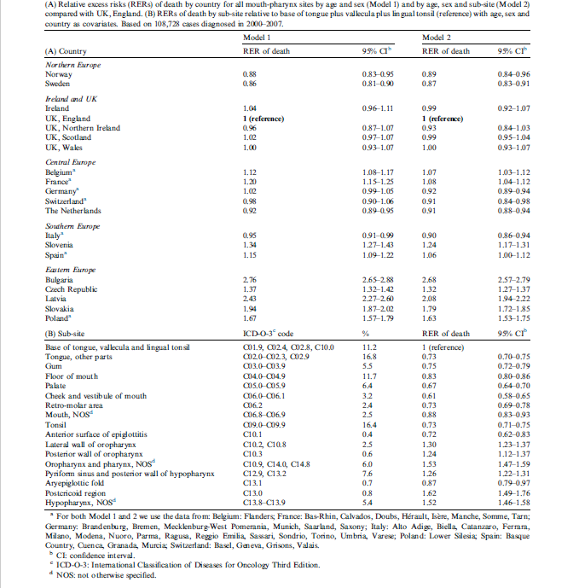













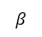
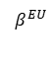
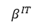
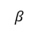
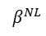
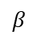
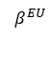
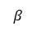
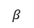
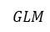
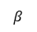
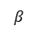
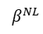
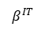
EUROCARE-5 original
EUROCARE-5 federated
$$β$$
$$β$$
$$β$$
$$β$$
$$β$$
$$β$$
$$β$$
$$β$$
$$β$$
$$β$$
$$β$$
$$β$$
$$GLM$$
$$β^{NL}$$
$$β^{NL}$$
$$β^{NL}$$
$$β^{EU}$$
$$β^{EU}$$
$$β^{EU}$$
$$β^{IT}$$
$$β^{IT}$$
$$β^{IT}$$

Slide 23
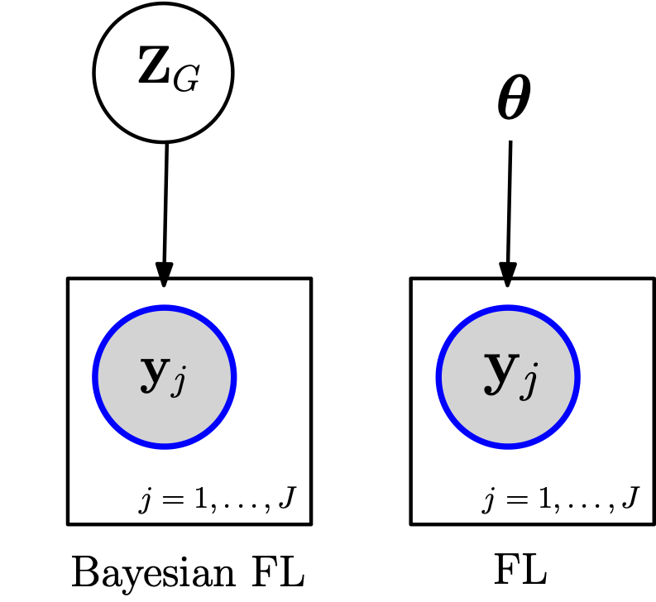
Current FL - open question
e.g., distributed MCMC methods, Laplace approximations for GLMs
Currently, only limited types of models are possible. Common models currently include:
GLMs
Gaussian processes
Neural nets
None of these models naturally have silo-specific variables.
Can we fit generic structured probabilistic models in the FL setting?
Can we accommodate heterogeneous data and partially siloed data?
e.g., MLE estimation of GLMs, training of neural nets

Slide 24
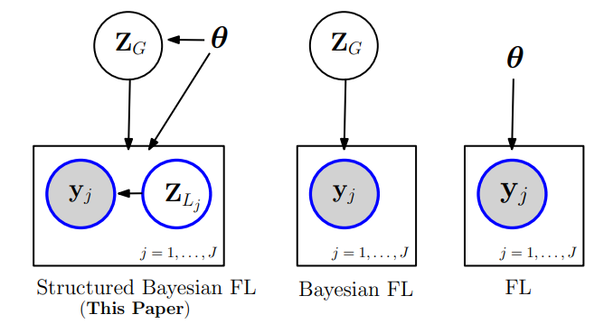
FL: Hierarchical spatial model (horizontal data)
Current approaches:
Same parameters for each party
e.g., GLM
Our interest: Bayesian structured models
hierarchical / mixed effects models, person or area-level random effects, fully or partially pooled regression, temporal effects, disjoint spatial random effects
Estimation: Variational Inference

Slide 25
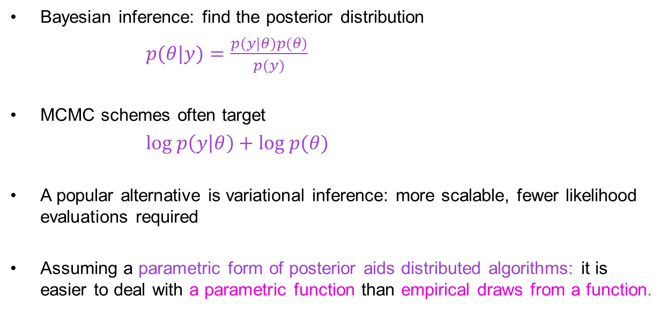
Bayesian Inference
Bayesian inference: find the posterior distribution
$p(θ|y)=\frac{p(y|θ)p(θ)}{p(y)}$
MCMC schemes often target
$log p\left(y | θ\right)+log p(θ)$
A popular alternative is variational inference: more scalable, fewer likelihood evaluations required
Assuming a parametric form of posterior aids distributed algorithms: it is easier to deal with a parametric function than empirical draws from a function.

Slide 26
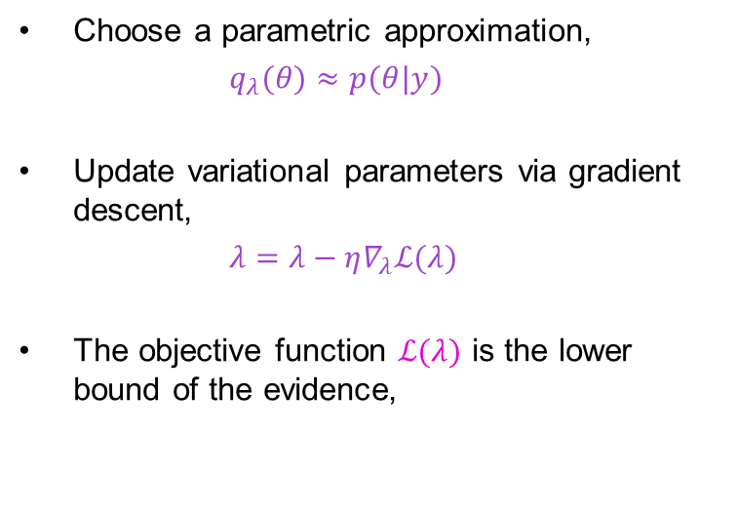
Variational inference
True posterior distribution
Closest approximate posterior distribution
Gaussian VI in a nutshell
Choose a parametric approximation,
$q_{λ}(θ)≈p(θ|y)$
Update variational parameters via gradient descent,
$λ=λ−η∇_{λ}ℒ(λ)$
The objective function $ℒ(λ)$ is the lower bound of the evidence,
$$ℒ(λ)=𝔼_{q_{λ}\left(θ\right)}[log p(θ|y)−log q_{λ}(θ)]$$
Space of all possible approximate posterior distributions given variational family
Space of all possible posterior distributions

Slide 27
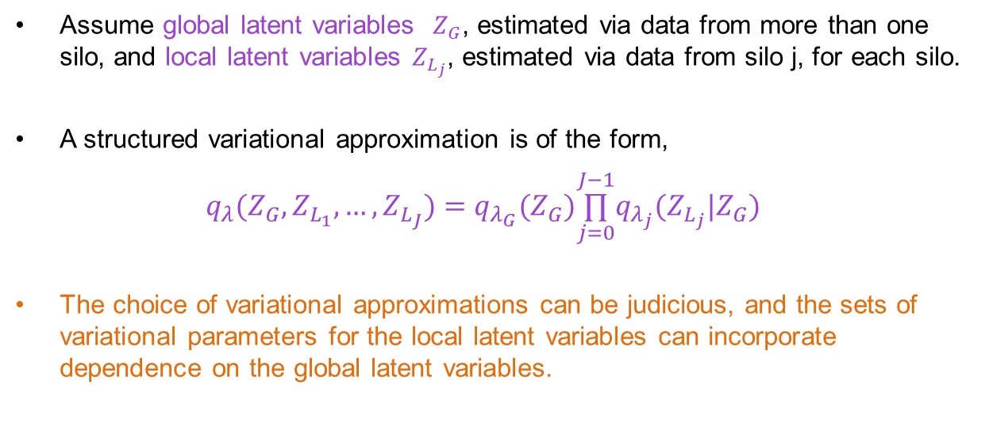
Conditionally Structured VI
Our choice of parametric approximation
Assume global latent variables $Z_{G}$, estimated via data from more than one silo, and local latent variables $Z_{L_{j}}$, estimated via data from silo j, for each silo.
A structured variational approximation is of the form,
$q_{λ}(Z_{G},Z_{L_{1}},…,Z_{L_{J}})=q_{λ_{G}}(Z_{G})\overset{J−1}{\underset{j=0}{∏}}q_{λ_{j}}(Z_{L_{j}}|Z_{G})$
The choice of variational approximations can be judicious, and the sets of variational parameters for the local latent variables can incorporate dependence on the global latent variables.

Slide 28
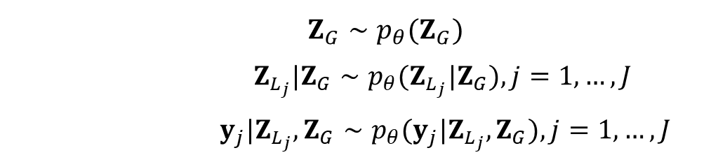
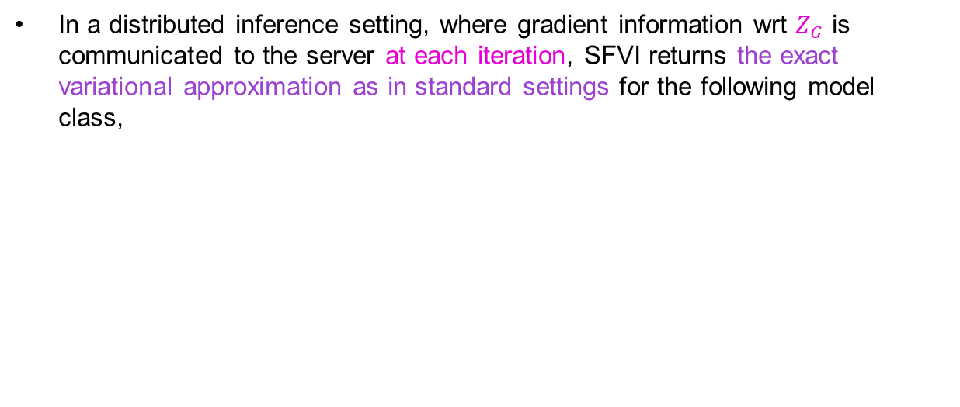
Structured Federated Variation Inference (SFVI)
Properties of the choice of approximation
In a distributed inference setting, where gradient information wrt $Z_{G}$ is communicated to the server at each iteration, SFVI returns the exact variational approximation as in standard settings for the following model class,
Model classes that this includes are,
Bayesian hierarchical models
Topic models
Hierarchical VAEs
…
$Z_{G}∼p_{θ}(Z_{G})$
$Z_{L_{j}}|Z_{G}∼p_{θ}(Z_{L_{j}}|Z_{G}),j=1,…,J$
$y_{j}|Z_{L_{j}},Z_{G}∼p_{θ}(y_{j}|Z_{L_{j}},Z_{G}),j=1,…,J$

Slide 29
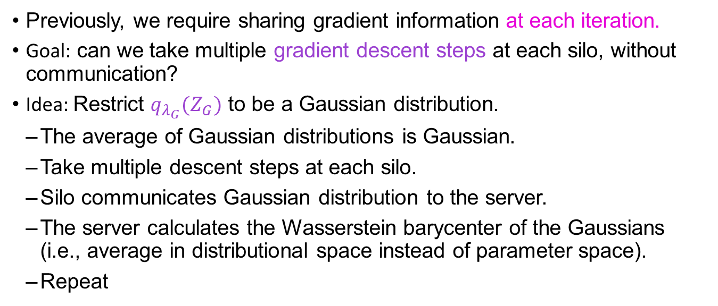
SFVI-Avg
A FedAvg analogue for structured variational inference
Previously, we require sharing gradient information at each iteration.
Goal: can we take multiple gradient descent steps at each silo, without communication?
Idea: Restrict $q_{λ_{G}}(Z_{G})$ to be a Gaussian distribution.
The average of Gaussian distributions is Gaussian.
Take multiple descent steps at each silo.
Silo communicates Gaussian distribution to the server.
The server calculates the Wasserstein barycenter of the Gaussians (i.e., average in distributional space instead of parameter space).
Repeat

Slide 30
FL Example
Federate spatial K-variable linear regressions over S regions
$$φ_{s} \sim MVN\left(0,D_{s}−A_{s}\right), j=1,..,S regions$$
$$μ_{k} \sim N\left(0,τ^{}=10\right), k=0, 1,..,K variables$$
$$σ_{k} \sim U\left(0.1,10\right), k=0, 1,..,K$$
$$β_{ks} \sim N\left(μ_{k},σ_{k}^{}\right), k=0, 1,..,K;s=1,.., S$$
$$η_{s}=\left(β_{ks}−\overline{φ_{s}} \right)+β_{1s}x_{s}+φ_{s}, s=1,..,S$$
$$y_{s }\sim Poisson(\exp{η_{s}), s=1,..,S}$$
$$θ_{G}=\left\{μ_{0},μ_{1}, …,μ_{K},σ_{0},σ_{1}, …,σ_{K}\right\}; θ_{s}=\{β_{0s},β_{1s},φ_{s}\}$$
ICAR prior

Slide 31
FL Example: Implementation
Compute log probability model using Tensorflow Probability
ICAR implemented via pairwise differencing plus soft constraint
Using NUTS sampling functionality from BlackJAX API. NUTS runtime: 55 seconds; including adaptive phase, chains = 40000 samples. All parameter effective sample sizes (ESS) greater than 9000.
Variational inference is implemented via the mean field approximation.
Runtime: 30 seconds; for 10000 gradient descent steps, the convergence of the objective function observed

Slide 32
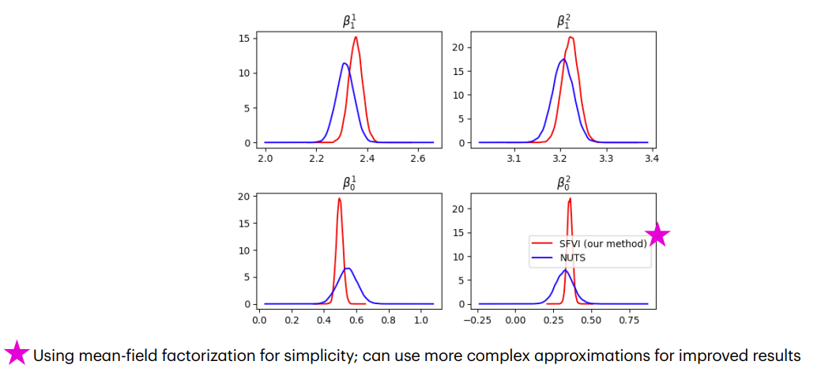
FL Example: Results

Slide 33
2. The challenge of complete data
Cancer risk data often obtained from surveys
2017-18 Australian Bureau of Statistics (ABS) National Health Survey (NHS) ≈ 17,000 adults
Small sample size – small area (SA2) sample size of 8 (IQR: 5–13)
Samples for ≈ 70% of areas (non-random)
~ 50% of SA2 are either nonsampled or unstable
Current small area estimation methods for proportions:
Individual-level models
Require covariate data for all population individuals
Cannot use survey-only covariates
Adjusts for sample design via modelling rather than sample weights
Area-level models
With very small sample sizes → unstable direct estimates
Insufficient understanding of performance for non-sampled areas

Slide 34
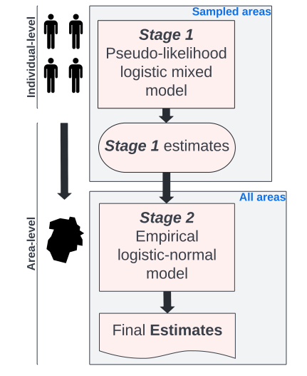
Two-stage model
Increased stability
Increased smoothing
Increased coverage

Slide 35
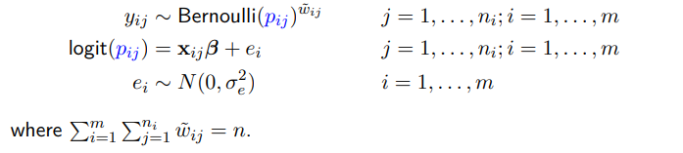


Stage 1 model (individual level)
X includes individual-level (chronic illness, other risk factors, etc) and area-level covariates (median income, employment rate, etc)

Slide 36


Stage 2 model (area level)
Z includes census variables for all areas

Slide 37

Application to ACA – Survey areas
5 risk factors:
Smoking
Alcohol
Diet
Weight
Physical activity

Slide 38


ACA – Stage 1 model + Stage 2 model

Slide 39

ACA – Results

Slide 40

ACA – Open results: Estimated proportions

Slide 41

ACA – Open results: Uncertainty

Slide 42

ACA – Open results: Pr(exceed national average)

Slide 43

3. The challenge of interpretable data

Slide 44

Visualisation: Communicating uncertainty – wave plot

Slide 45
Conclusion
Digital platforms can be effective conduits for open data
Open data challenges addressed by the Australian Cancer Atlas:
Private Data Spatial models, Federated learning
Complete Data Two-stage model
Interpretable Data Visualisations, inferences (e.g., clustering)

Slide 46

Added value: Clustering
Approaches (Wala Areed)
Spatial Gaussian mixture
Spatial Dirichlet mixture

Slide 47

Conclusion: “So what?”

Slide 48
References
Duncan E, Cramb S, Baade P, Mengersen K, Saunders T, Aitken J. (2020) 'Developing a Cancer Atlas using Bayesian Methods: A Practical Guide for Application and Interpretation' (Available here)
Hassan C, Salomone R, Mengersen, K. (2023) Federated Variational Inference Methods for Structured Latent Variable Models. (ArXiv)
Hogg J, Cameron J, Cramb S, Baade P, Mengersen K. (2023) 'A two-stage Bayesian small area estimation method for proportions' (ArXiv)
Areed W, Price A, Arnett K, Thompson H, Malseed R, Mengersen K. (2023) 'Assessing the spatial structure of the association between attendance at preschool and children’s development vulnerabilities in Queensland, Australia', PLOS ONE (Available here)

